Slide 1



Flux Tunable Superconducting Quantum Circuit Based on Weyl Semimetal MoTe2
By Kuei-Lin Chiu,* Degui Qian, Jiawei Qiu, Weiyang Liu, Dian Tan, Vahid Mosallanejad, Song Liu, Zongteng Zhang, Yue Zhao, and Dapeng Yu.
報告者 : 謝凱閔
指導教授: 邱奎霖 教授
日期 : 2020/12/28
1.

Slide 2
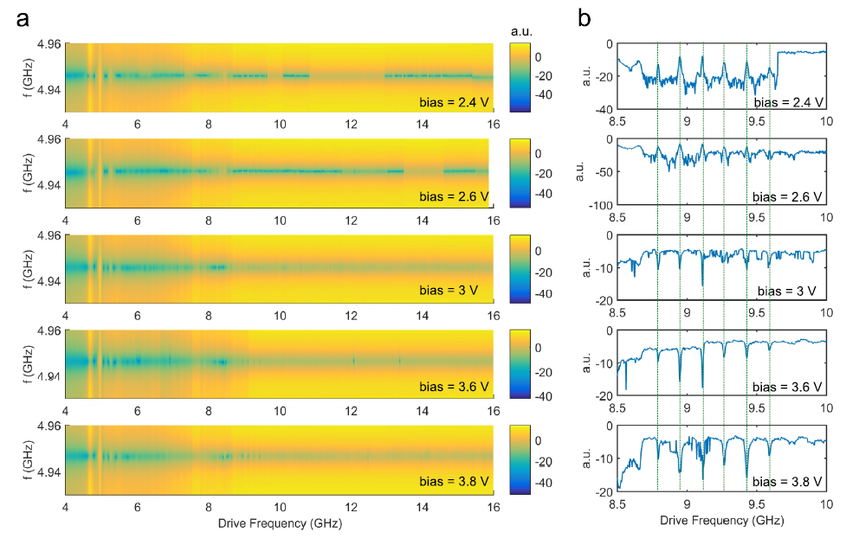
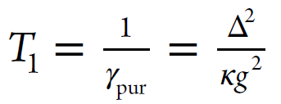


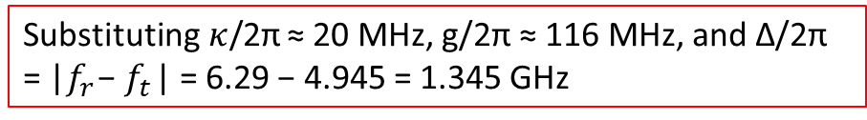


III. DEVICE CHARACTERIZATION AND RESULTS
Two-tone measurement,雙頻率測量:
Probe tone applied to the readout line(around $f_{r}$)；Pump tone applied to the XY-control line(around $f_{t}$).
Relaxation time $T_{1}$ (set by Purcell effect)
# However, no shift in cavity frequency was observed
→ Very short coherence time
孔. 3.1.2
$$f_{r}$$
孔. eq(2.6.4)
: Transmon decay rate (set by Purcell effect )
Substituting$κ$/2π ≈ 20 MHz, g/2π ≈ 116 MHz, and Δ/2π = |$f_{r}$ − $f_{t}$ | = 6.29 − 4.945 = 1.345 GHz
S5.Two-tone spectroscopy. S21 measured as a function of readout-in frequency (readout line ,y-axis) and drive frequency(XY-control line, RF source ,x-axis)
12.
Notes:
Qubit的自發輻射受CPW耗散(Cavity)影響
via χ = g^2/Δ,
g:腔與qubit偶合強度

Slide 3
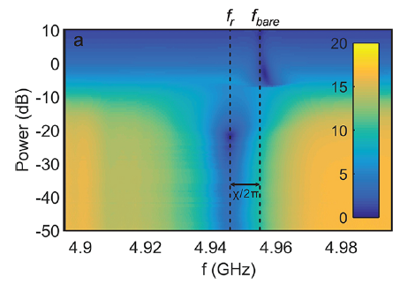
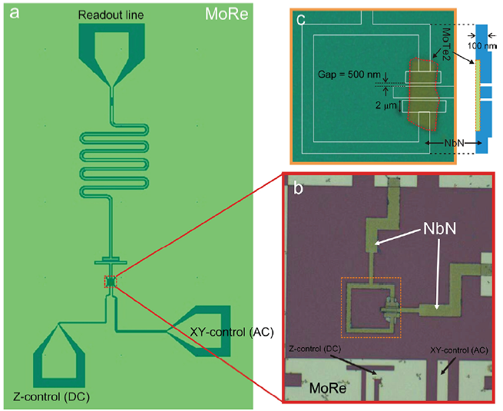
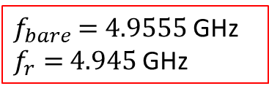
III. DEVICE CHARACTERIZATION AND RESULTS
$f_{bare}$ = 4.9555 GHz
$f_{r}=$4.945 GHz
Probe tone
12.

Slide 4
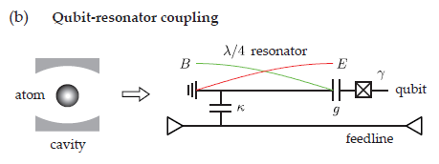
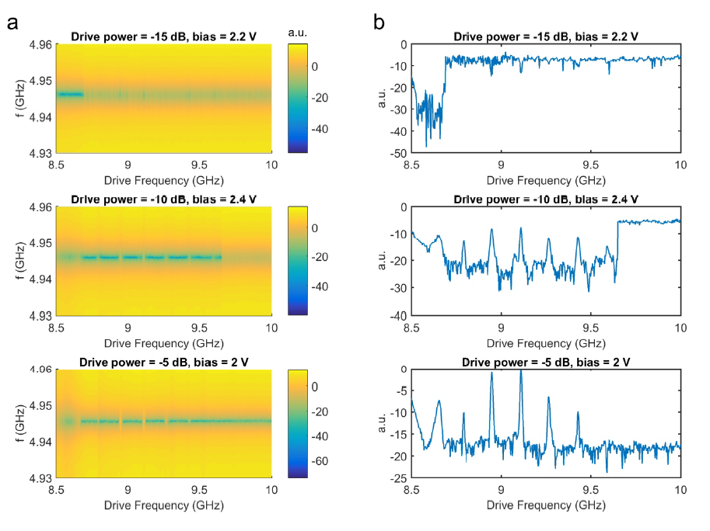

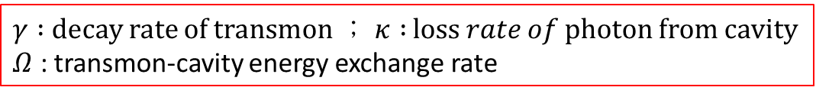
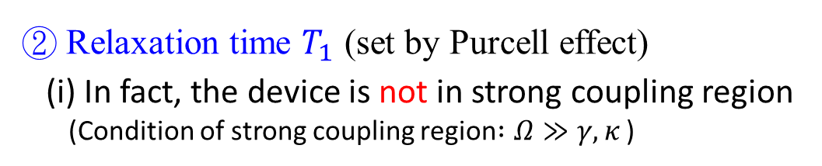
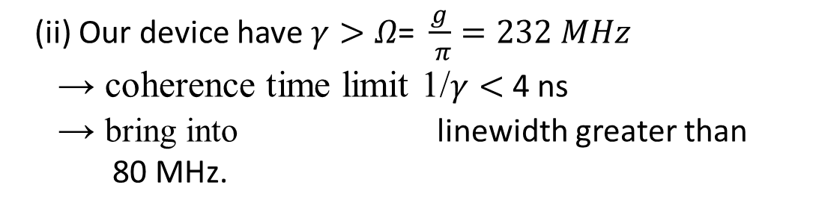
III. DEVICE CHARACTERIZATION AND RESULTS
② Relaxation time $T_{1}$ (set by Purcell effect)
(i) In fact, the device is not in strong coupling region
(Condition of strong coupling region$:Ω≫γ,κ$ )
$γ :$ decay rate of transmon$； κ :$ loss 𝑟𝑎𝑡𝑒 𝑜𝑓 photon from cavity
$Ω$ : transmon-cavity energy exchange rate
(ii) Our device have$γ>Ω\text{=} \frac{g}{ π}=232 MHz$
→ coherence time limit 1/$γ<$ 4 ns
→ bring into linewidth greater than
80 MHz.
(iii) Standing wave in the coaxial cables:
we can observed a periodic feature in the linecuts
for high enough drive tone powers.
(readout-in tone power is -22 dB)
12.
S6.Two-tone spectroscopy.
Notes:
1 GHz=1000 MHz

Slide 5
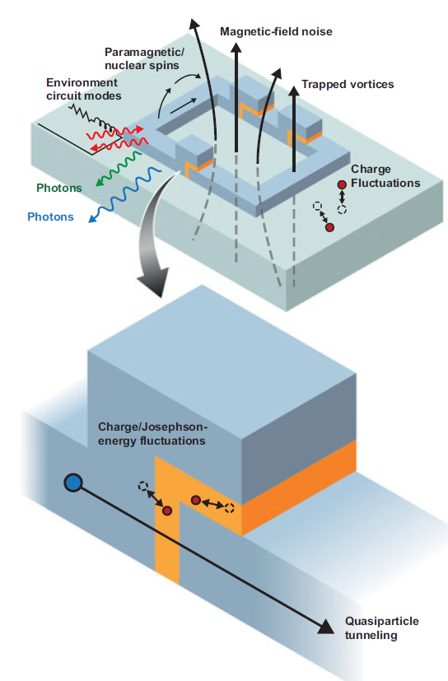
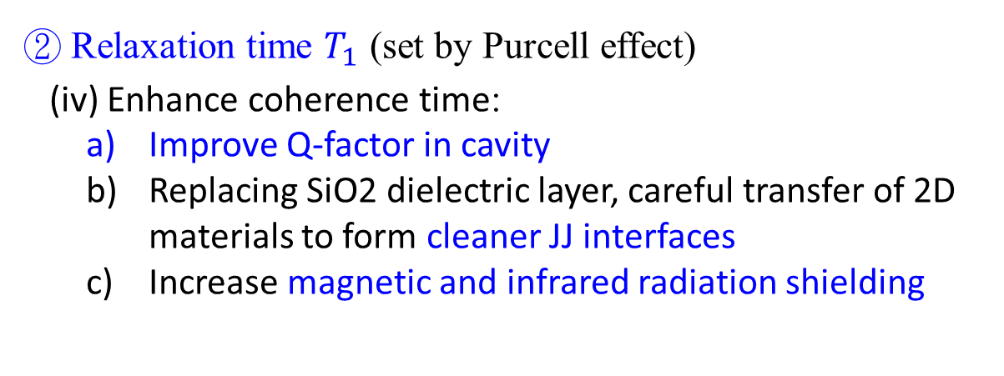
III. DEVICE CHARACTERIZATION AND RESULTS
② Relaxation time $T_{1}$ (set by Purcell effect)
(iv) Enhance coherence time:
Improve Q-factor in cavity
Replacing SiO2 dielectric layer, careful transfer of 2D materials to form cleaner JJ interfaces
Increase magnetic and infrared radiation shielding
Materials in superconducting quantum bits
(William D. Oliver and Paul B. Welander)
12.

Slide 6
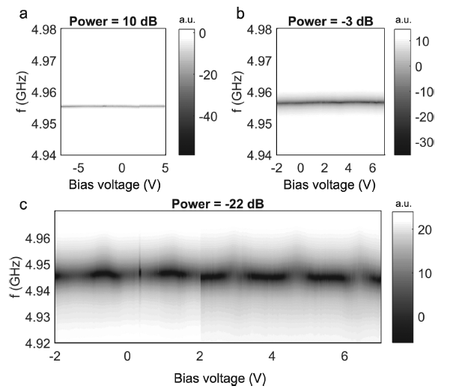
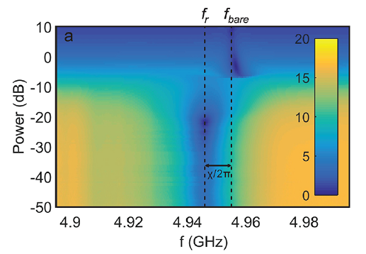


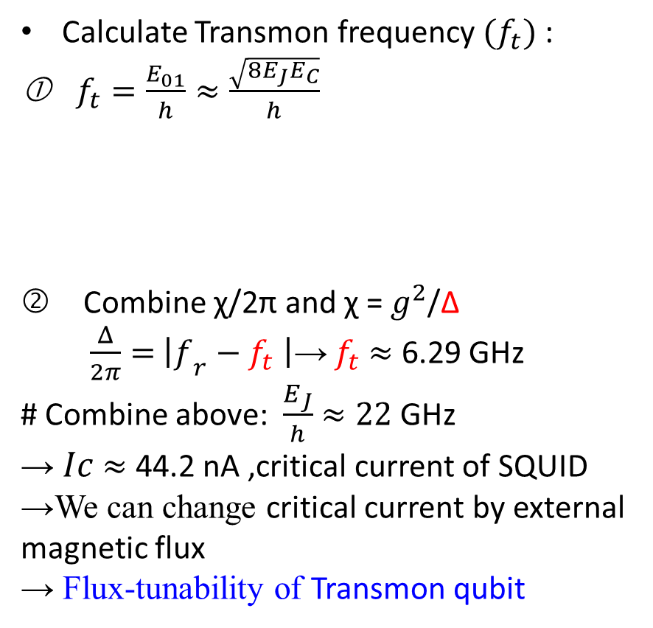
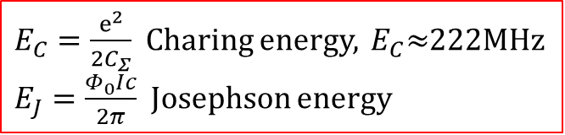
III. DEVICE CHARACTERIZATION AND RESULTS
Calculate Transmon frequency ${(f}_{t})$:
$f_{t}=\frac{E_{01}}{h}≈\frac{\sqrt{8E_{J}E_{C}}}{h}$
Combine χ/2π and χ = $g^{2}$/Δ
$\frac{Δ}{2π}=$ ${\left|f\right.}_{r}−f_{t}$ $\left|\text{→}\right.$ $f_{t}$ $≈$ 6.29 GHz
# Combine above: $\frac{E_{J}}{h}$ $≈22$ GHz
→ $Ic$ $≈$ 44.2 nA ,critical current of SQUID
→We can change critical current by external magnetic flux
→ Flux-tunability of Transmon qubit
$E_{C}=\frac{ⅇ^{2}}{2C_{Σ}}$ Charing energy, ${ E}_{C}≈$222MHz
$E_{J}=\frac{Φ_{0}Ic}{2π}$ Josephson energy
$$f_{bare}$$
$$f_{r}$$
Fig 3. S21 as a function of readout-in frequency and bias voltage (magnetic field)
#The flux modulation is absent if readout-in powers high enough
12.
Notes:
在極大光場(大功率)的時候，讀取腔是無法看到transmon的貢獻，所以即便transmon 頻率隨磁通改變了，我們看不到讀取頻率的改變

Slide 7
III. DEVICE CHARACTERIZATION AND RESULTS
$f_{bare}$ = 4.9555 GHz
$f_{r}=$4.945 GHz
12.

Slide 8
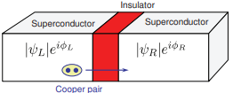
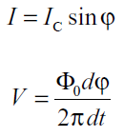
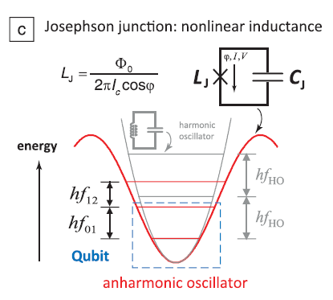

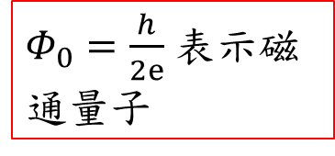
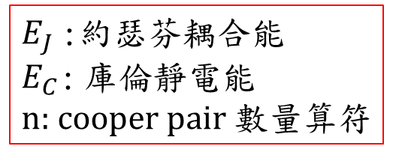
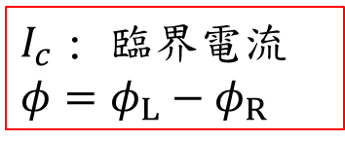
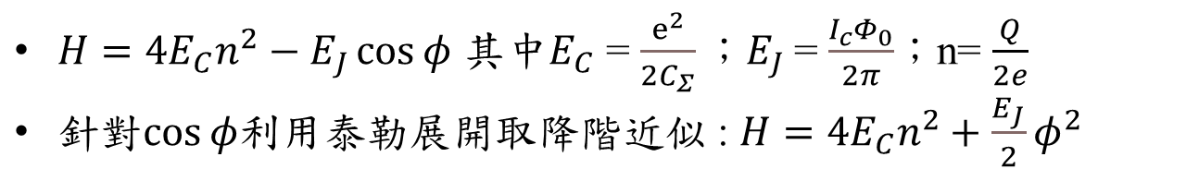


原理介紹-約瑟夫森結(Josephson Junction)
$I_{c}$ : 臨界電流
$$φ=φ_{L}−φ_{R}$$
$Φ_{0}=\frac{h}{2ⅇ}$ 表示磁通量子
利用 $V=L_{J}\frac{ⅆI}{ⅆt}$
非線性諧振子的成因!
平行板狀結構
$$C_{J}$$
$H=4E_{C}n^{2}−E_{J}\cos{φ}$ 其中$E_{C}$ = $\frac{ⅇ^{2}}{2C_{Σ}}；E_{J}$= $\frac{I_{c}Φ_{0}}{2π}$；n= $\frac{Q}{2e}$
$針對cos{φ}$利用泰勒展開取降階近似 : $H=4E_{C}n^{2}+\frac{E_{J}}{2}φ^{2}$
$E_{J}$:約瑟芬耦合能
$E_{C} \text{:}$庫倫靜電能
n: cooper pair 數量算符
3.
Notes:
當絕緣層夠薄(接近10nm) 庫柏電⼦對有機率穿隧絕緣層即是量⼦穿隧實驗
超導電流只隨著兩超導體的波函數相位差的正弦變化，沒有牽涉任何純量勢與向量勢
約瑟芬耦合能和接面電阻大小有關，它代表的是超導庫柏電子對是否容易通過接面。但可以藉由外加磁場來調控
庫倫靜電能則主要來自電容的影響，代表著電荷的穿隧是否容易受到靜電累積而阻斷。受到幾何結構所限制

Slide 9

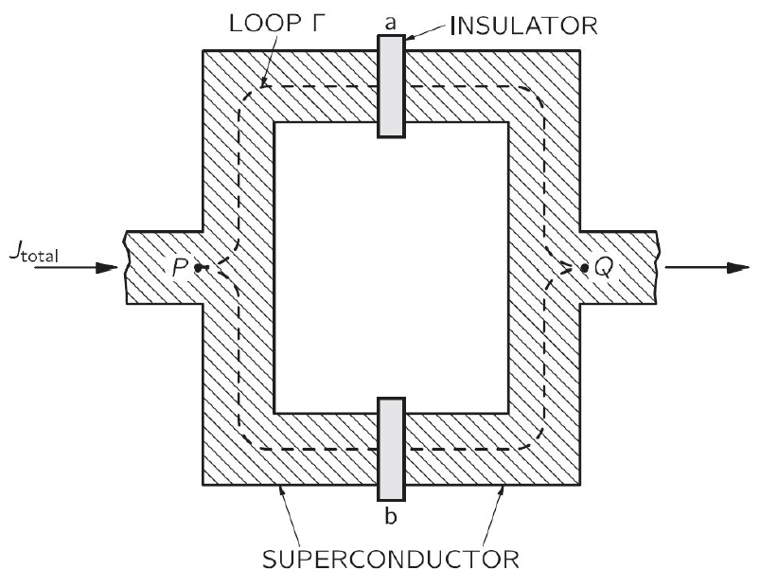


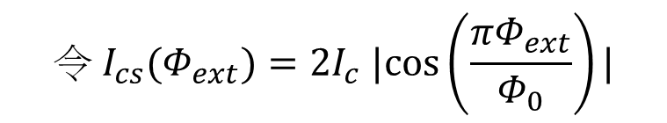

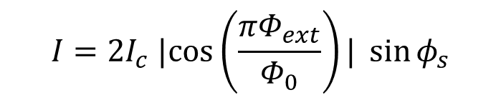


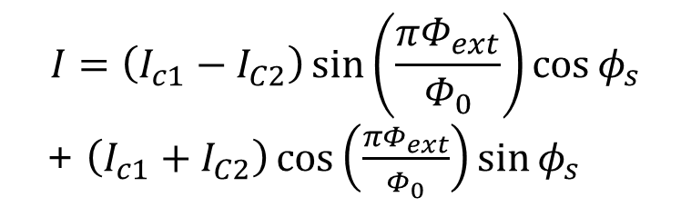


約瑟夫森結-SQUID對稱型
$${\text{→}I}_{c1} ,φ_{1}$$
….(1)
….(2)
$$Φ_{ext}$$
將(1)帶入(2) , 配合$φ_{1}+φ_{2}$= $φ_{s}$
$$I=\left(I_{c1}−I_{C2}\right)\sin\left(\frac{πΦ_{ext}}{Φ_{0}}\right)\cos{φ_{s}}$$
+ $\left(I_{c1}+I_{C2}\right)\cos\left(\frac{πΦ_{ext}}{Φ_{0}}\right)\sin{φ_{s}}$
$${\text{→}I}_{c2} ,φ_{2}$$
$$I=2I_{c} |cos\left(\frac{πΦ_{ext}}{Φ_{0}}\right)| \sin{φ_{s}}$$
如果SQUID對稱 : $I_{c1}$= $I_{c2}=$ $I_{c}$
$$令 I_{cs}(Φ_{ext})=2I_{c} |cos\left(\frac{πΦ_{ext}}{Φ_{0}}\right)|$$
$I=I_{cs}(Φ_{ext})$ $\sin{φ_{s}}$
可將SQUID視為一個可靠外部調控臨界電流的約瑟夫森結

Slide 10
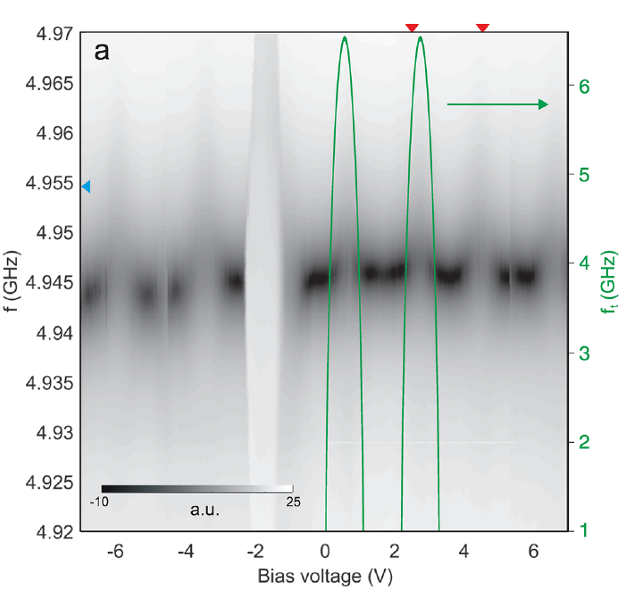
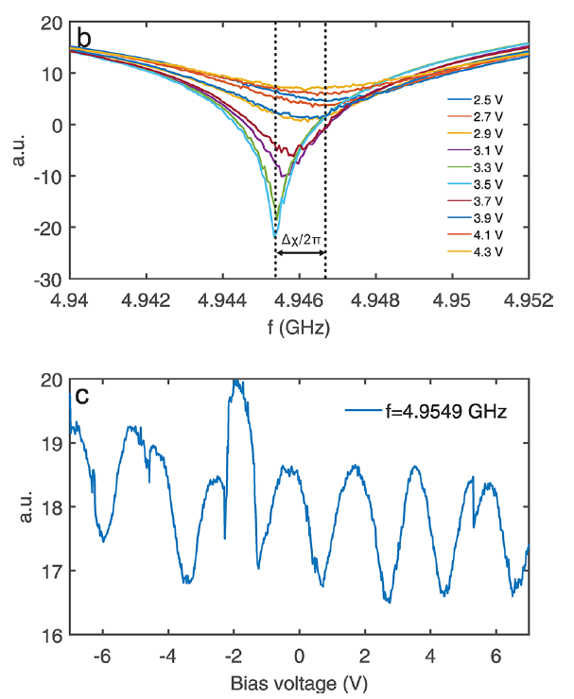
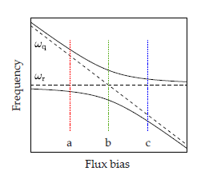
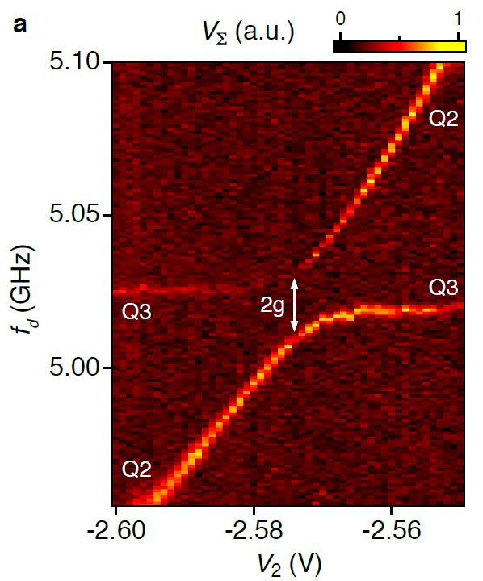


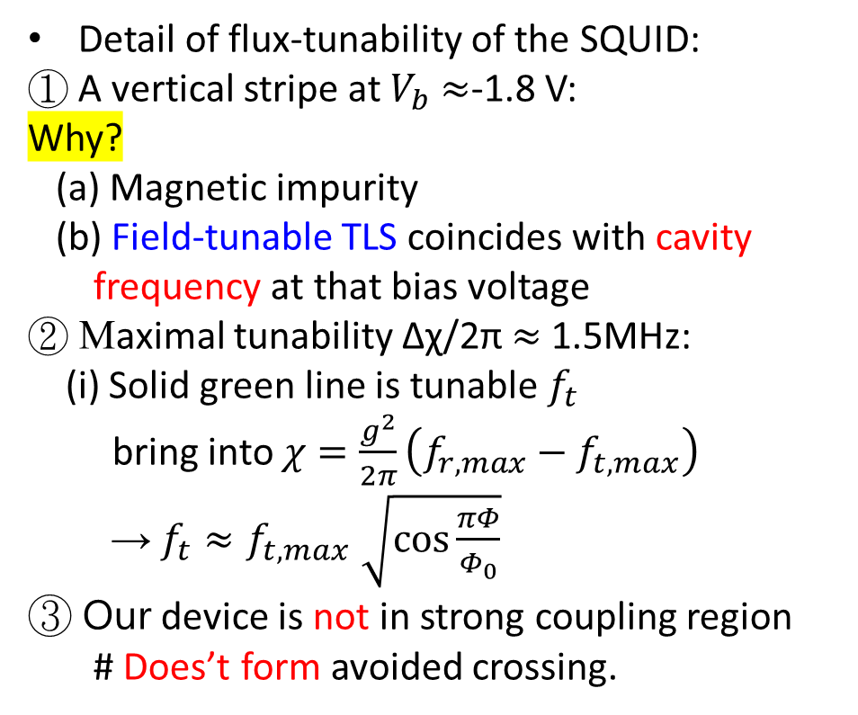
III. DEVICE CHARACTERIZATION AND RESULTS
Detail of flux-tunability of the SQUID:
① A vertical stripe at $V_{b}$ $≈$-1.8 V:
Why?
(a) Magnetic impurity
(b) Field-tunable TLS coincides with cavity
frequency at that bias voltage
② Maximal tunability Δχ/2π $≈$1.5MHz:
(i) Solid green line is tunable $f_{t}$
bring into $χ=\frac{g^{2}}{2π}\left(f_{r,max}−f_{t,max}\right)$
→ $f_{t}{≈f}_{t,max}\sqrt{cos\frac{πΦ}{Φ_{0}}}$
③ Our device is not in strong coupling region
# Does’t form avoided crossing.
ΔV
$$f_{r}$$
Δχ
$$f_{t}$$
ΔV
12.

Slide 11






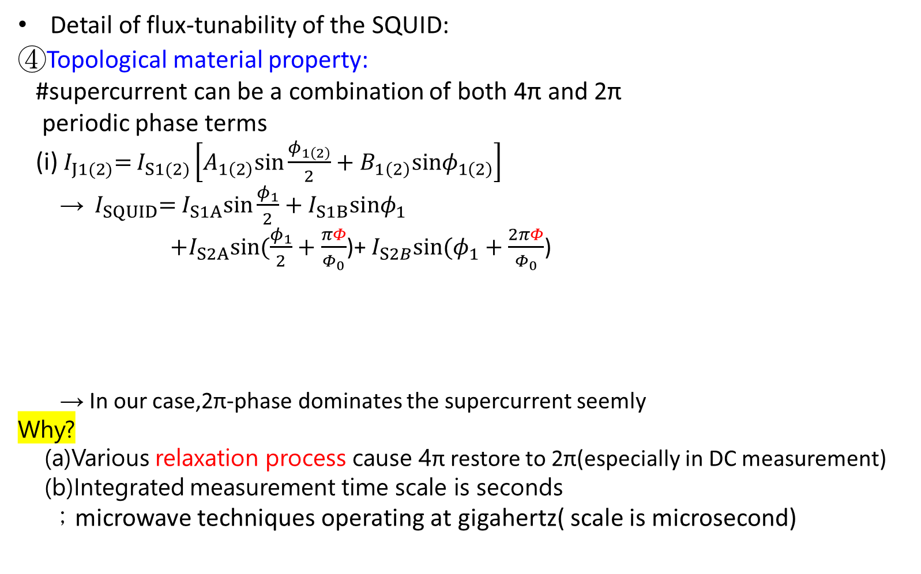

III. DEVICE CHARACTERIZATION AND RESULTS
Detail of flux-tunability of the SQUID:
④Topological material property:
#supercurrent can be a combination of both 4π and 2π
periodic phase terms
(i)${ I}_{J1(2)}=$ $I_{S1(2)}\left[A_{1\left(2\right)}sin\frac{φ_{1\left(2\right)}}{2}+B_{1\left(2\right)}sinφ_{1\left(2\right)}\right]$
→ ${ I}_{SQUID}=$ $I_{S1A}sin\frac{φ_{1}}{2}+I_{S1B}sinφ_{1}$
$+I_{S2A}sin(\frac{φ_{1}}{2}+\frac{πΦ}{Φ_{0}}$)+ $I_{S2B}sin(φ_{1}+\frac{2πΦ}{Φ_{0}}$)
→ In our case,2π-phase dominates the supercurrent seemly
Why?
(a)Various relaxation process cause 4π restore to 2π(especially in DC measurement)
(b)Integrated measurement time scale is seconds
；microwave techniques operating at gigahertz( scale is microsecond)
$$f_{r}$$
$$\text{4}\text{π}$$
$$\text{2}\text{π}$$
$$f_{t}$$
$$\text{4}\text{π}$$
$$\text{2}\text{π}$$
$φ_{2}=φ_{1}+\frac{2πΦ}{Φ_{0}}$ ； $Φ_{0}$ : flux quantum
Fig 4a. S21 as a function of readout-in frequency and bias voltage (periodic flux tuning)
(behavior of conventional transmon made of Al/Al2O3-based SQUID)

Slide 12
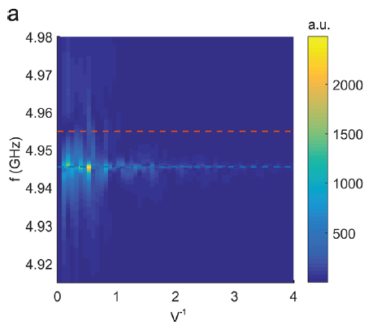
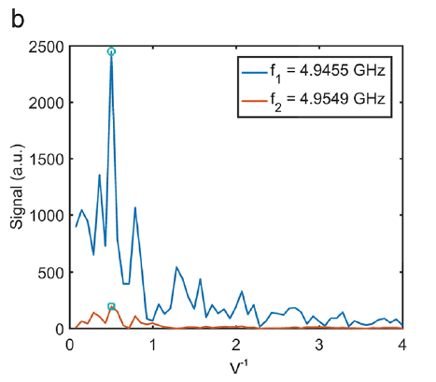
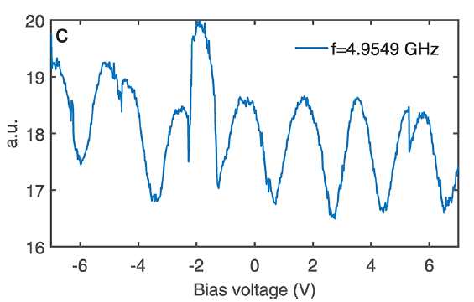
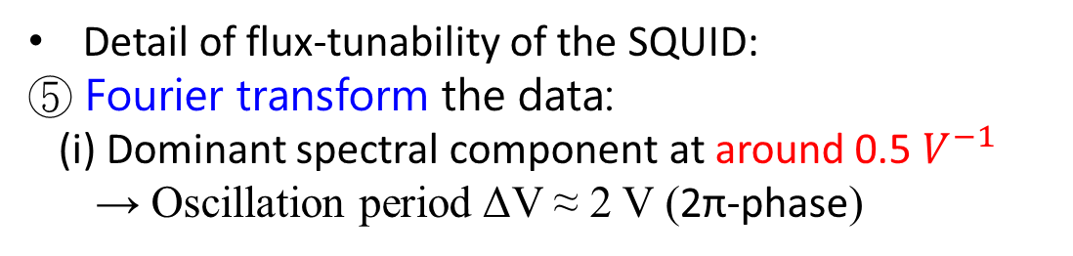
III. DEVICE CHARACTERIZATION AND RESULTS
Detail of flux-tunability of the SQUID:
⑤ Fourier transform the data:
(i) Dominant spectral component at around 0.5 $V^{−1}$
→ Oscillation period ΔV ≈ 2 V (2π-phase)
Component around 0.5 $V^{−1}\text{→}$ 2π-phase
Component around 0.25 $V^{−1}\text{→}$ 4π-phase
0.5
FT
Fig 5a.Fourier spectrum of data shown in Fig 4a.
Fig 4c.
Fig 5b.Fourier spectrum of data shown in Fig 4c.
12.

Slide 13
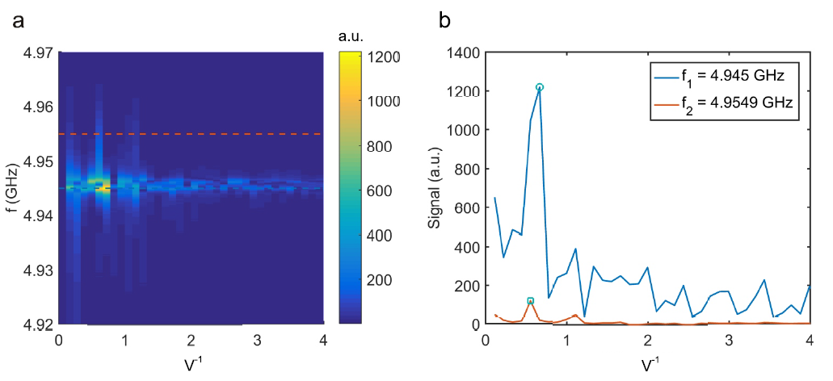
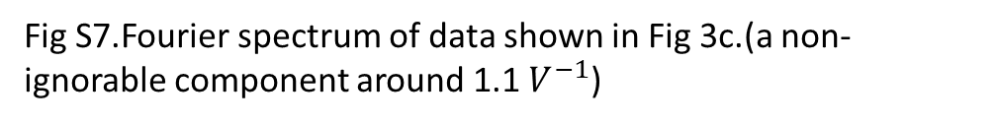
III. DEVICE CHARACTERIZATION AND RESULTS
0.5
FT
Fig S7.Fourier spectrum of data shown in Fig 3c.(a non-ignorable component around 1.1 $V^{−1}$)
12.

Slide 14
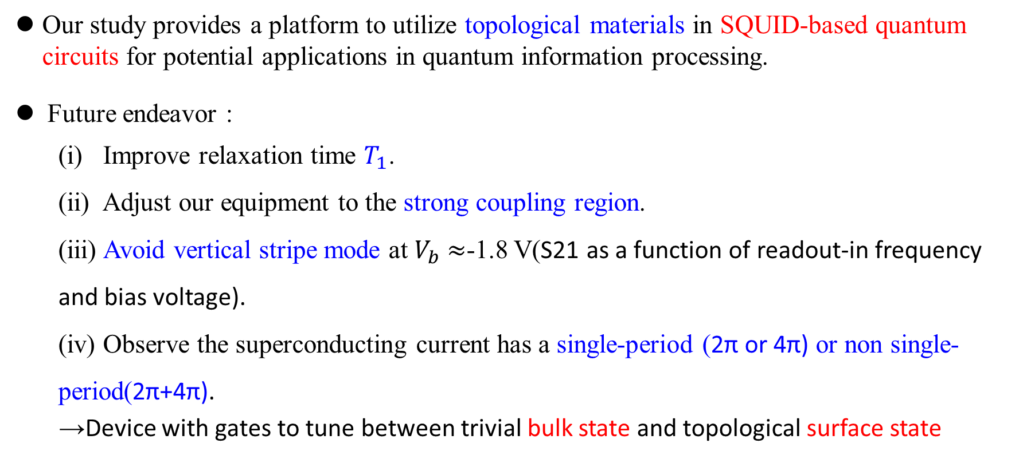
IV. SUMMARY
Our study provides a platform to utilize topological materials in SQUID-based quantum circuits for potential applications in quantum information processing.
Future endeavor :
(i) Improve relaxation time $T_{1}$.
(ii) Adjust our equipment to the strong coupling region.
(iii) Avoid vertical stripe mode at $V_{b}$ $≈$-1.8 V(S21 as a function of readout-in frequency and bias voltage).
(iv) Observe the superconducting current has a single-period (2π or 4π) or non single-period(2π+4π).
→Device with gates to tune between trivial bulk state and topological surface state
12.

